Slide 1


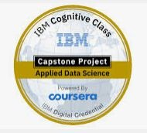
Business Project
Open Coffee Shop Nearby Supermarket
Capstone Project - The Battle of Neighborhoods Applied Data Science Capstone
Gangadhar Bhuvan
August - 2020

Slide 2
Business Problem :
Deciding to run my own business by opening new Coffee shop with only Take Away service. For that we need to find suitable and proper location for it.
By considering :
The Coffee Shop need to be near by Supermarket.
List of supermarkets existing in the City.
List of the Coffee Shops near to each Supermarket.

Slide 3
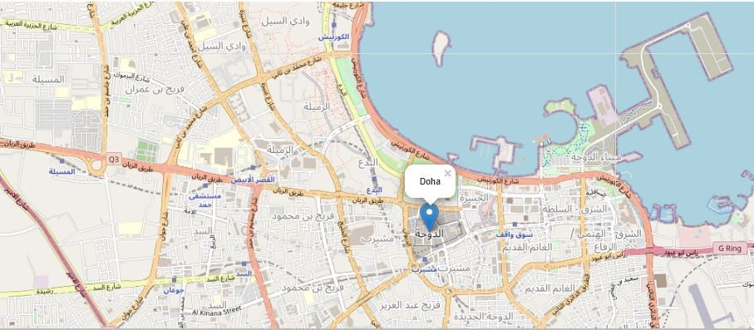
Data :
Obtaining the Geo coordinates of the city.
With Foursquare API:
Finding the list of the Supermarkets in the city
Finding the list of the Coffee Shops near to each the Supermarket
The Central point : Doha - Qatar

Slide 4
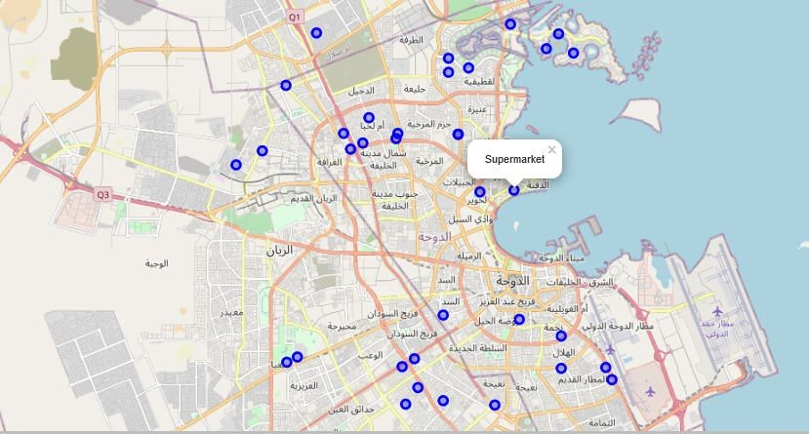
Data Wrangling and Cleaning :
Within perimeter of 25Km around the city, we found :
- 40 Supermarkets.
Tracking the Coffee Shops existing near by the supermarkets:
- 120 Coffee Shop and Café
The both subcategory had been considered in our Dataframe.

Slide 5
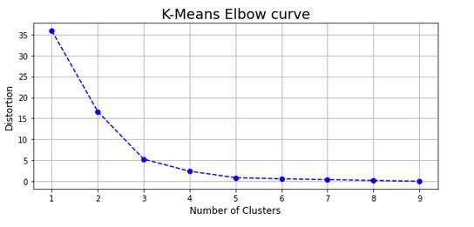
Methodology :
Conda, Geopy & Folium : for Geo Coordinates and mapping
Foursquare API : to retrieve the supermarkets and the coffee Shops existing from the city
Pandas : to merge the both Dataframes of the Coffee shops near to supermarkets.
K-means : Clusters the Supermarkets.
Depending on the Elbow method , 3 clusters has been calculated.

Slide 6
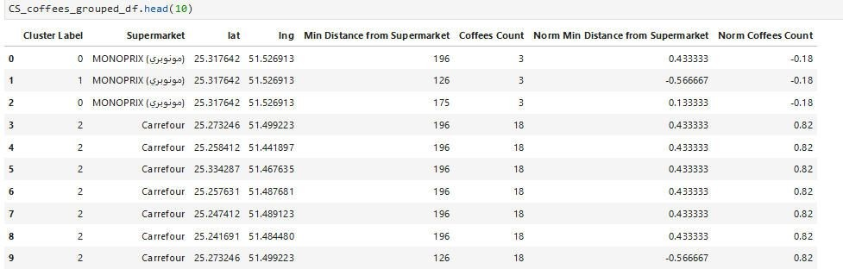
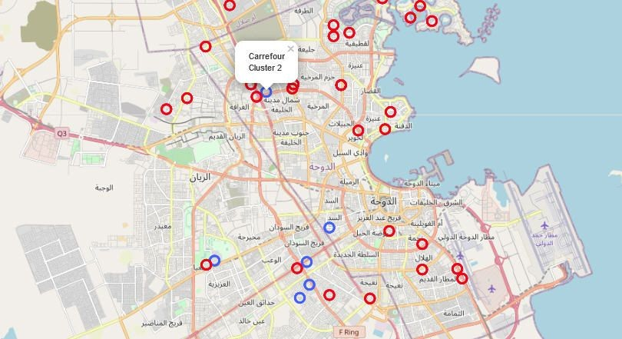
Result :
Supermarkets Clusters Map

Slide 7
Discussion :
We found that the cluster 1 and 2 and similar with little bit of difference on the distance of the coffee shops.
The both clusters (1 & 2) have small numbers of coffee shops near by the supermarkets
Regarding the cluster 3 : having the same distance from the supermarkets however with big number of coffee shops around the target.

Slide 8
Conclusion :
We can go for the 1 cluster, however others points and parameters need to be considered :
Opening time of the supermarkets.
Customers frequency.
Bus stations near by.
Possibility to open at the entrance and the exit of the supermarkets.
Property price.

